Slide 1
Lecture 5:
Training Neural Networks,
Part I

Slide 2
Administrative
A1 is due today (midnight)
I’m holding make up office hours on today: 5pm @ Gates 259
A2 will be released ~tomorrow. It’s meaty, but educational!
Also:
We are shuffling the course schedule around a bit
the grading scheme is subject to few % changes

Slide 3
Things you should know for your Project Proposal
“ConvNets need a lot of data to train”

Slide 4

Things you should know for your Project Proposal
“ConvNets need a lot of data to train”
finetuning! we rarely ever
train ConvNets from scratch.

Slide 5
Train on ImageNet
2. Finetune network on your own data
ImageNet data
your data

Slide 6
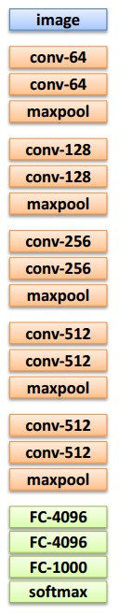
Transfer Learning with CNNs
1. Train on
ImageNet
2. If small dataset: fix all weights (treat CNN as fixed feature extractor), retrain only the classifier
i.e. swap the Softmax layer at the end
3. If you have medium sized dataset, “finetune” instead: use the old weights as initialization, train the full network or only some of the higher layers
retrain bigger portion of the network, or even all of it.

Slide 7
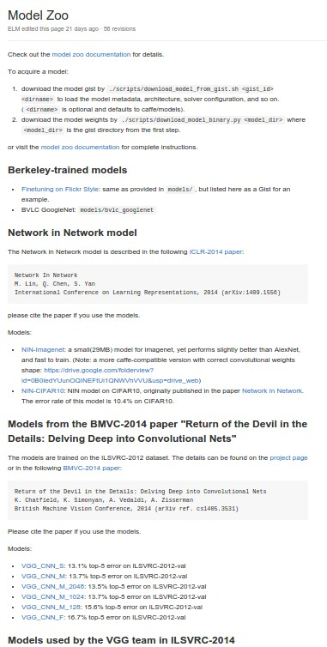
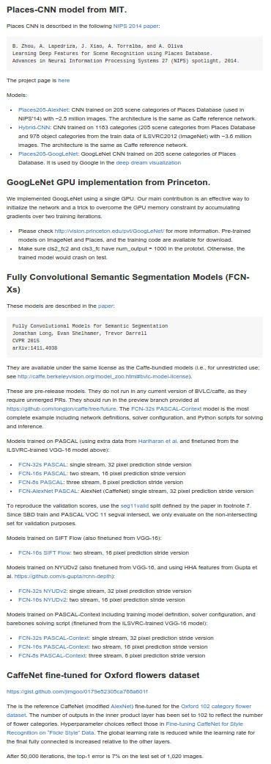
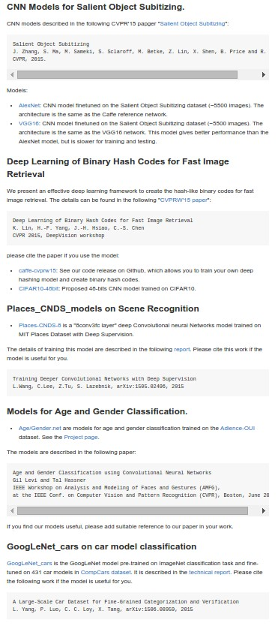
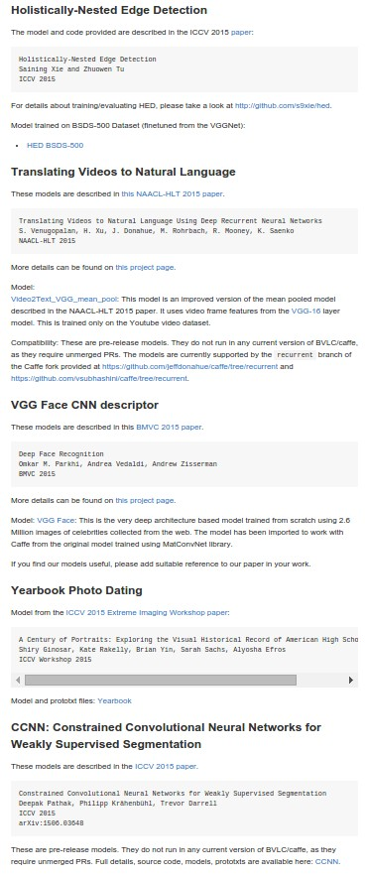
E.g. Caffe Model Zoo: Lots of pretrained ConvNets
https://github.com/BVLC/caffe/wiki/Model-Zoo
...

Slide 8
Things you should know for your Project Proposal
“We have infinite compute available because Terminal.”

Slide 9
Things you should know for your Project Proposal
“We have infinite compute available because Terminal.”
You have finite compute.
Don’t be overly ambitious.

Slide 10
Where we are now...
Mini-batch SGD
Loop:
Sample a batch of data
Forward prop it through the graph, get loss
Backprop to calculate the gradients
Update the parameters using the gradient

Slide 11



Where we are now...
(image credits
to Alec Radford)

Slide 12
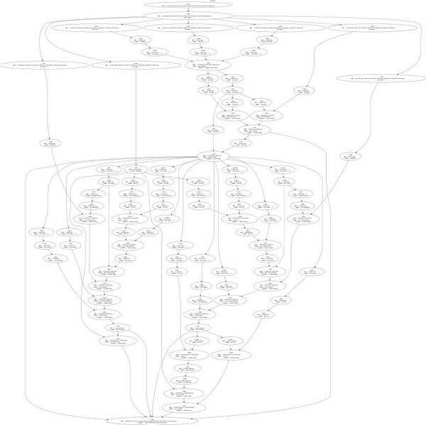
Neural Turing Machine
input tape
loss

Slide 13
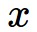
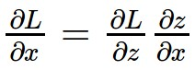
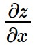
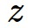
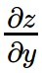
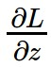
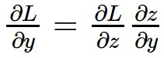
activations
f
“local gradient”
gradients

Slide 14
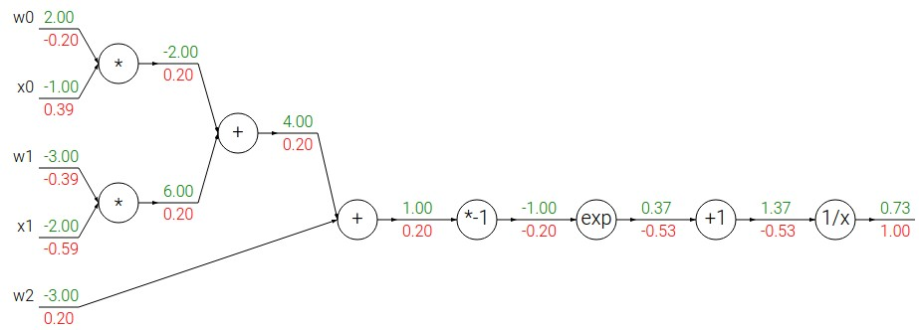
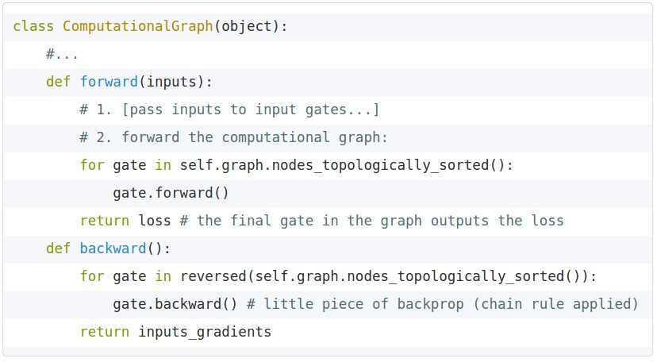
Implementation: forward/backward API
Graph (or Net) object. (Rough psuedo code)

Slide 15
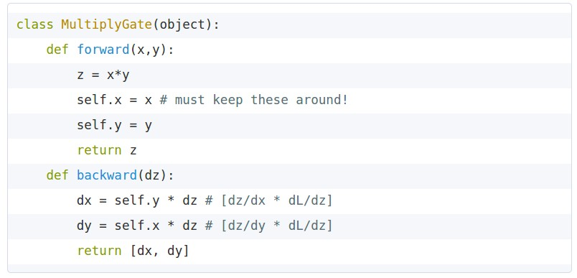

Implementation: forward/backward API
x
z
*
y
(x,y,z are scalars)

Slide 16
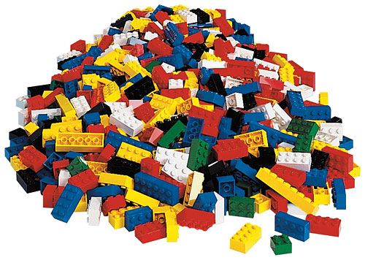
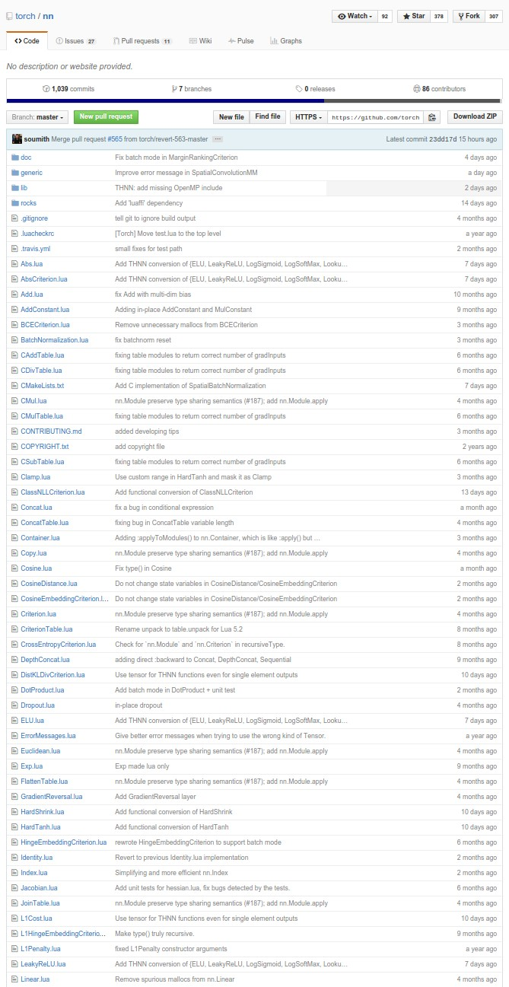
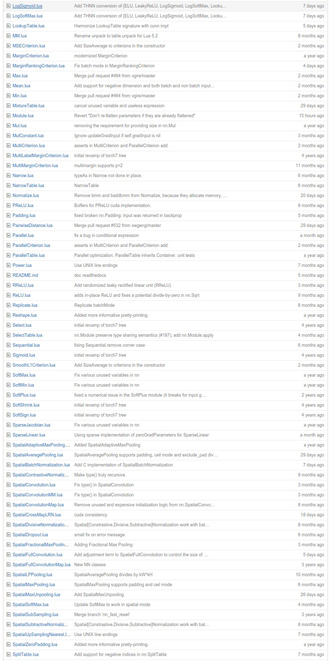
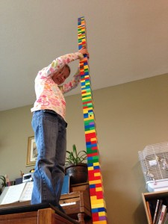
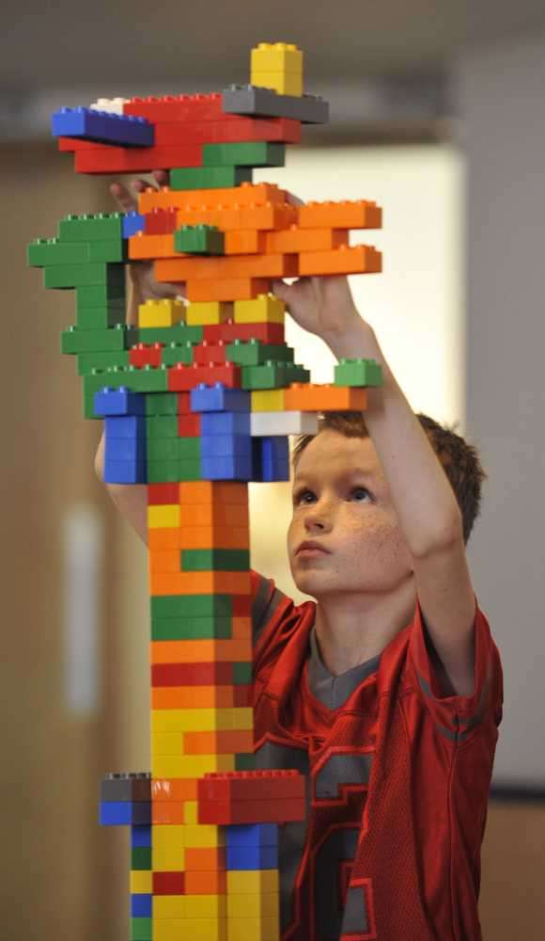
Example: Torch Layers
=

Slide 17
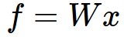
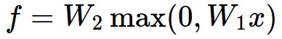
Neural Network: without the brain stuff
(Before) Linear score function:
(Now) 2-layer Neural Network
or 3-layer Neural Network

Slide 18


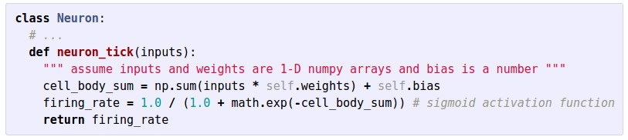

Slide 19


Neural Networks: Architectures
“3-layer Neural Net”, or
“2-hidden-layer Neural Net”
“2-layer Neural Net”, or
“1-hidden-layer Neural Net”
“Fully-connected” layers

Slide 20
Training Neural Networks
A bit of history...

Slide 21
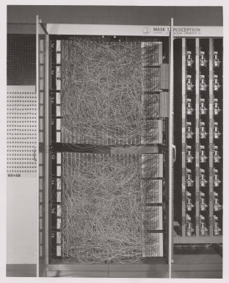
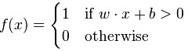
A bit of history
The Mark I Perceptron machine was the first implementation of the perceptron algorithm.
The machine was connected to a camera that used 20×20 cadmium sulfide photocells to produce a 400-pixel image.
recognized
letters of the alphabet
update rule:
Frank Rosenblatt, ~1957: Perceptron

Slide 22
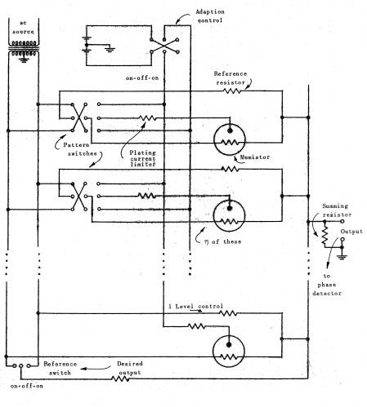
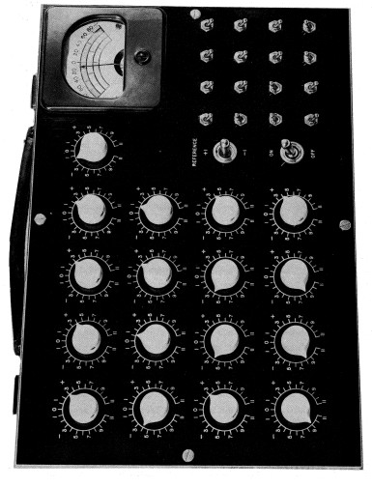
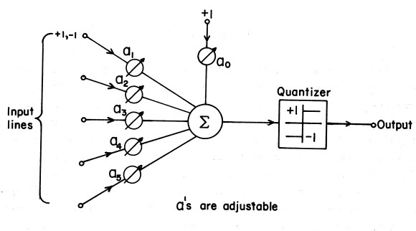
A bit of history
Widrow and Hoff, ~1960: Adaline/Madaline

Slide 23
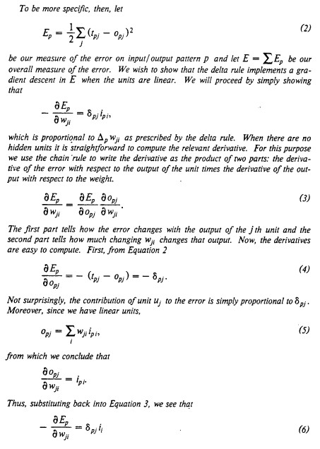
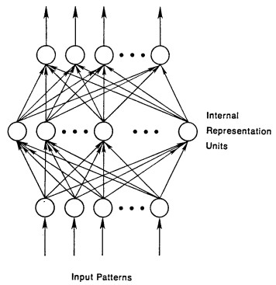
A bit of history
recognizable maths
Rumelhart et al. 1986: First time back-propagation became popular

Slide 24
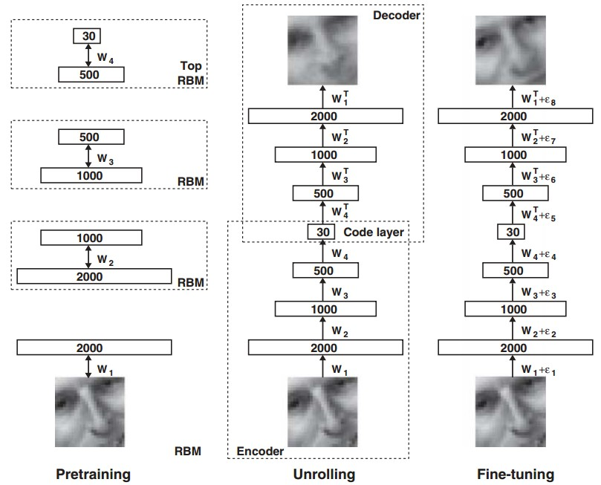
A bit of history
[Hinton and Salakhutdinov 2006]
Reinvigorated research in Deep Learning

Slide 25
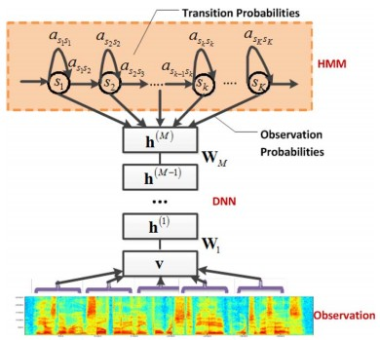
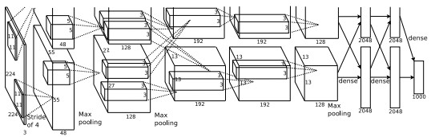
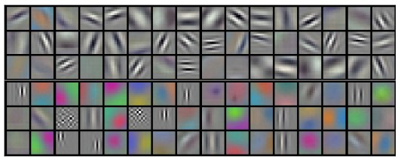
First strong results
Context-Dependent Pre-trained Deep Neural Networks
for Large Vocabulary Speech Recognition
George Dahl, Dong Yu, Li Deng, Alex Acero, 2010
Imagenet classification with deep convolutional
neural networks
Alex Krizhevsky, Ilya Sutskever, Geoffrey E Hinton, 2012

Slide 26
Overview
One time setup
activation functions, preprocessing, weight initialization, regularization, gradient checking
Training dynamics
babysitting the learning process,
parameter updates, hyperparameter optimization
Evaluation
model ensembles

Slide 27
Activation Functions

Slide 28
Activation Functions

Slide 29
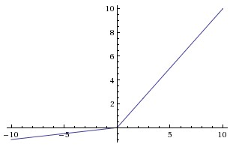
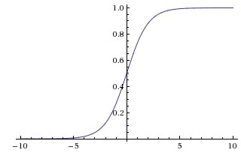
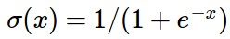
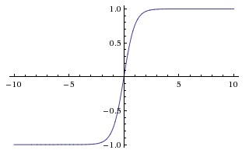
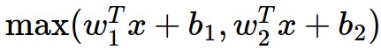
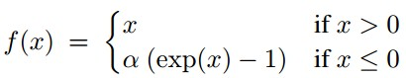
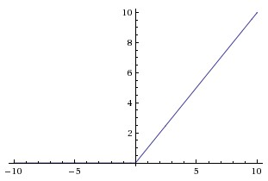
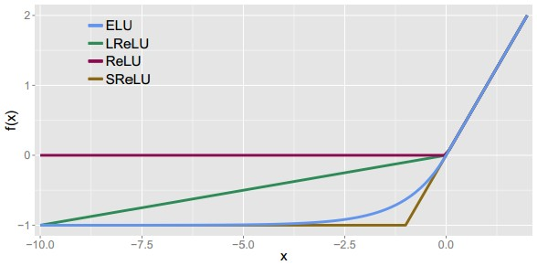
Activation Functions
Leaky ReLU
max(0.1x, x)
Sigmoid
Maxout
tanh tanh(x)
ELU
ReLU max(0,x)

Slide 30
Activation Functions
Squashes numbers to range [0,1]
Historically popular since they have nice interpretation as a saturating “firing rate” of a neuron
Sigmoid

Slide 31
Activation Functions
Squashes numbers to range [0,1]
Historically popular since they have nice interpretation as a saturating “firing rate” of a neuron
3 problems:
Saturated neurons “kill” the gradients
Sigmoid

Slide 32
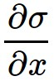
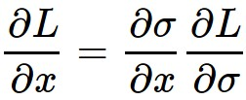
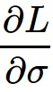
sigmoid
gate
x
What happens when x = -10?
What happens when x = 0?
What happens when x = 10?

Slide 33
Activation Functions
Squashes numbers to range [0,1]
Historically popular since they have nice interpretation as a saturating “firing rate” of a neuron
3 problems:
Saturated neurons “kill” the gradients
Sigmoid outputs are not zero-centered
Sigmoid

Slide 34
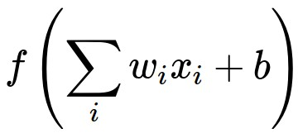
Consider what happens when the input to a neuron (x)
is always positive:
What can we say about the gradients on w?

Slide 35
Consider what happens when the input to a neuron is always positive...
allowed gradient update directions
zig zag path
allowed gradient update directions
hypothetical optimal w vector
What can we say about the gradients on w?
Always all positive or all negative :(
(this is also why you want zero-mean data!)

Slide 36
Activation Functions
Squashes numbers to range [0,1]
Historically popular since they have nice interpretation as a saturating “firing rate” of a neuron
3 problems:
Saturated neurons “kill” the gradients
Sigmoid outputs are not zero-centered
exp() is a bit compute expensive
Sigmoid

Slide 37
Activation Functions
Squashes numbers to range [-1,1]
zero centered (nice)
still kills gradients when saturated :(
tanh(x)
[LeCun et al., 1991]

Slide 38
Activation Functions
Computes f(x) = max(0,x)
Does not saturate (in +region)
Very computationally efficient
Converges much faster than sigmoid/tanh in practice (e.g. 6x)
ReLU
(Rectified Linear Unit)
[Krizhevsky et al., 2012]

Slide 39
Activation Functions
Computes f(x) = max(0,x)
Does not saturate (in +region)
Very computationally efficient
Converges much faster than sigmoid/tanh in practice (e.g. 6x)
Not zero-centered output
An annoyance:
hint: what is the gradient when x < 0?
ReLU
(Rectified Linear Unit)

Slide 40
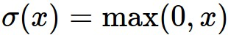
ReLU
gate
x
What happens when x = -10?
What happens when x = 0?
What happens when x = 10?

Slide 41
DATA CLOUD
active ReLU
dead ReLU
will never activate
=> never update

Slide 42
DATA CLOUD
active ReLU
=> people like to initialize ReLU neurons with slightly positive biases (e.g. 0.01)
dead ReLU
will never activate
=> never update

Slide 43
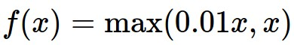
Activation Functions
[Mass et al., 2013]
[He et al., 2015]
Does not saturate
Computationally efficient
Converges much faster than sigmoid/tanh in practice! (e.g. 6x)
will not “die”.
Leaky ReLU

Slide 44
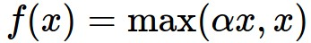
Activation Functions
[Mass et al., 2013]
[He et al., 2015]
Does not saturate
Computationally efficient
Converges much faster than sigmoid/tanh in practice! (e.g. 6x)
will not “die”.
Parametric Rectifier (PReLU)
Leaky ReLU
backprop into \alpha
(parameter)

Slide 45


Activation Functions
[Clevert et al., 2015]
Exponential Linear Units (ELU)
All benefits of ReLU
Does not die
Closer to zero mean outputs
Computation requires exp()

Slide 46
Maxout “Neuron”
Does not have the basic form of dot product -> nonlinearity
Generalizes ReLU and Leaky ReLU
Linear Regime! Does not saturate! Does not die!
[Goodfellow et al., 2013]
Problem: doubles the number of parameters/neuron :(

Slide 47
TLDR: In practice:
Use ReLU. Be careful with your learning rates
Try out Leaky ReLU / Maxout / ELU
Try out tanh but don’t expect much
Don’t use sigmoid

Slide 48
Data Preprocessing

Slide 49



Step 1: Preprocess the data
(Assume X [NxD] is data matrix, each example in a row)

Slide 50

Step 1: Preprocess the data
In practice, you may also see PCA and Whitening of the data
(data has diagonal covariance matrix)
(covariance matrix is the identity matrix)

Slide 51
TLDR: In practice for Images: center only
e.g. consider CIFAR-10 example with [32,32,3] images
Subtract the mean image (e.g. AlexNet)
(mean image = [32,32,3] array)
Subtract per-channel mean (e.g. VGGNet)
(mean along each channel = 3 numbers)
Not common to normalize variance, to do PCA or whitening

Slide 52
Weight Initialization

Slide 53
Q: what happens when W=0 init is used?

Slide 54
First idea: Small random numbers
(gaussian with zero mean and 1e-2 standard deviation)

Slide 55
First idea: Small random numbers
(gaussian with zero mean and 1e-2 standard deviation)
Works ~okay for small networks, but can lead to non-homogeneous distributions of activations across the layers of a network.

Slide 56

Lets look at some activation statistics
E.g. 10-layer net with 500 neurons on each layer, using tanh non-linearities, and initializing as described in last slide.

Slide 57


Slide 58
All activations become zero!
Q: think about the backward pass. What do the gradients look like?
Hint: think about backward pass for a W*X gate.

Slide 59

Almost all neurons completely saturated, either -1 and 1. Gradients will be all zero.
*1.0 instead of *0.01

Slide 60

“Xavier initialization”
[Glorot et al., 2010]
Reasonable initialization.
(Mathematical derivation assumes linear activations)

Slide 61

but when using the ReLU nonlinearity it breaks.

Slide 62

He et al., 2015
(note additional /2)

Slide 63

He et al., 2015
(note additional /2)

Slide 64
Proper initialization is an active area of research…
Understanding the difficulty of training deep feedforward neural networks
by Glorot and Bengio, 2010
Exact solutions to the nonlinear dynamics of learning in deep linear neural networks by Saxe et al, 2013
Random walk initialization for training very deep feedforward networks by Sussillo and Abbott, 2014
Delving deep into rectifiers: Surpassing human-level performance on ImageNet classification by He et al., 2015
Data-dependent Initializations of Convolutional Neural Networks by Krähenbühl et al., 2015
All you need is a good init, Mishkin and Matas, 2015
…

Slide 65

Batch Normalization
[Ioffe and Szegedy, 2015]
“you want unit gaussian activations? just make them so.”
consider a batch of activations at some layer. To make each dimension unit gaussian, apply:
this is a vanilla differentiable function...

Slide 66
Batch Normalization
[Ioffe and Szegedy, 2015]
“you want unit gaussian activations?
just make them so.”
1. compute the empirical mean and variance independently for each dimension.
X
N
2. Normalize
D

Slide 67
Batch Normalization
[Ioffe and Szegedy, 2015]
FC
Usually inserted after Fully Connected / (or Convolutional, as we’ll see soon) layers, and before nonlinearity.
BN
tanh
FC
Problem: do we necessarily want a unit gaussian input to a tanh layer?
BN
tanh
...

Slide 68



Batch Normalization
[Ioffe and Szegedy, 2015]
Normalize:
Note, the network can learn:
And then allow the network to squash
the range if it wants to:
to recover the identity mapping.

Slide 69

Batch Normalization
[Ioffe and Szegedy, 2015]
Improves gradient flow through the network
Allows higher learning rates
Reduces the strong dependence on initialization
Acts as a form of regularization in a funny way, and slightly reduces the need for dropout, maybe

Slide 70
Batch Normalization
[Ioffe and Szegedy, 2015]
Note: at test time BatchNorm layer functions differently:
The mean/std are not computed based on the batch. Instead, a single fixed empirical mean of activations during training is used.
(e.g. can be estimated during training with running averages)

Slide 71
Babysitting the Learning Process

Slide 72
Step 1: Preprocess the data
(Assume X [NxD] is data matrix, each example in a row)

Slide 73
Step 2: Choose the architecture:
say we start with one hidden layer of 50 neurons:
50 hidden neurons
10 output neurons, one per class
output layer
CIFAR-10 images, 3072 numbers
input layer
hidden layer

Slide 74


Double check that the loss is reasonable:
disable regularization
loss ~2.3.
“correct “ for
10 classes
returns the loss and the gradient for all parameters

Slide 75

Double check that the loss is reasonable:
crank up regularization
loss went up, good. (sanity check)

Slide 76

Lets try to train now…
Tip: Make sure that you can overfit very small portion of the training data
The above code:
take the first 20 examples from CIFAR-10
turn off regularization (reg = 0.0)
use simple vanilla ‘sgd’

Slide 77

Lets try to train now…
Tip: Make sure that you can overfit very small portion of the training data
Very small loss,
train accuracy 1.00,
nice!

Slide 78

Lets try to train now…
I like to start with small regularization and find learning rate that makes the loss go down.

Slide 79
Lets try to train now…
I like to start with small regularization and find learning rate that makes the loss go down.
Loss barely changing

Slide 80
Lets try to train now…
I like to start with small regularization and find learning rate that makes the loss go down.
loss not going down:
learning rate too low
Loss barely changing: Learning rate is probably too low

Slide 81
Lets try to train now…
I like to start with small regularization and find learning rate that makes the loss go down.
loss not going down:
learning rate too low
Loss barely changing: Learning rate is probably too low
Notice train/val accuracy goes to 20% though, what’s up with that? (remember this is softmax)

Slide 82

Lets try to train now…
I like to start with small regularization and find learning rate that makes the loss go down.
loss not going down:
learning rate too low
Okay now lets try learning rate 1e6. What could possibly go wrong?

Slide 83
Lets try to train now…
I like to start with small regularization and find learning rate that makes the loss go down.
loss not going down:
learning rate too low
loss exploding:
learning rate too high
cost: NaN almost always means high learning rate...

Slide 84

Lets try to train now…
I like to start with small regularization and find learning rate that makes the loss go down.
loss not going down:
learning rate too low
loss exploding:
learning rate too high
3e-3 is still too high. Cost explodes….
=> Rough range for learning rate we should be cross-validating is somewhere [1e-3 … 1e-5]

Slide 85
Hyperparameter Optimization

Slide 86
Cross-validation strategy
I like to do coarse -> fine cross-validation in stages
First stage: only a few epochs to get rough idea of what params work
Second stage: longer running time, finer search
… (repeat as necessary)
Tip for detecting explosions in the solver:
If the cost is ever > 3 * original cost, break out early

Slide 87


For example: run coarse search for 5 epochs
note it’s best to optimize in log space!
nice

Slide 88


Now run finer search...
adjust range
53% - relatively good for a 2-layer neural net with 50 hidden neurons.

Slide 89
Now run finer search...
adjust range
53% - relatively good for a 2-layer neural net with 50 hidden neurons.
But this best cross-validation result is worrying. Why?

Slide 90

Random Search vs. Grid Search
Random Search for Hyper-Parameter Optimization
Bergstra and Bengio, 2012

Slide 91

Hyperparameters to play with:
network architecture
learning rate, its decay schedule, update type
regularization (L2/Dropout strength)
neural networks practitioner
music = loss function

Slide 92

My cross-validation “command center”

Slide 93


Monitor and visualize the loss curve

Slide 94
Loss
time

Slide 95
Loss
Bad initialization
a prime suspect
time

Slide 96



lossfunctions.tumblr.com
Loss function specimen

Slide 97


lossfunctions.tumblr.com

Slide 98


lossfunctions.tumblr.com

Slide 99

Monitor and visualize the accuracy:
big gap = overfitting
=> increase regularization strength?
no gap
=> increase model capacity?

Slide 100

Track the ratio of weight updates / weight magnitudes:
ratio between the values and updates: ~ 0.0002 / 0.02 = 0.01 (about okay)
want this to be somewhere around 0.001 or so

Slide 101
Summary
We looked in detail at:
Activation Functions (use ReLU)
Data Preprocessing (images: subtract mean)
Weight Initialization (use Xavier init)
Batch Normalization (use)
Babysitting the Learning process
Hyperparameter Optimization
(random sample hyperparams, in log space when appropriate)
TLDRs

Slide 102
TODO
Look at:
Parameter update schemes
Learning rate schedules
Gradient Checking
Regularization (Dropout etc)
Evaluation (Ensembles etc)

